Slide 1
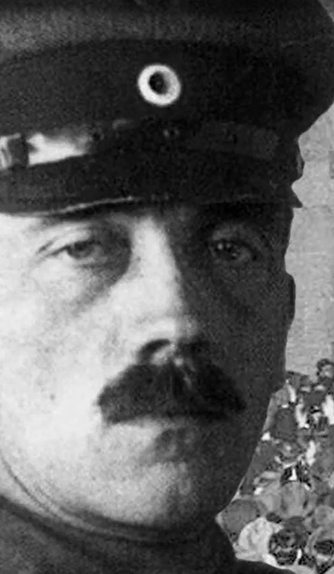
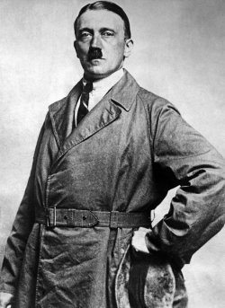
Hitler’s Rise to Power
10HASS3
Week 4.1
Notes:
Picture credit: SV Bilderdienst / DIZ Muenchen / The Image Works
Sourced from https://www.facinghistory.org/resource-library/image/adolf-hitler-1924?backlink=https://www.facinghistory.org/resource-library/video/hitlers-rise-power-1918-1933

Slide 2
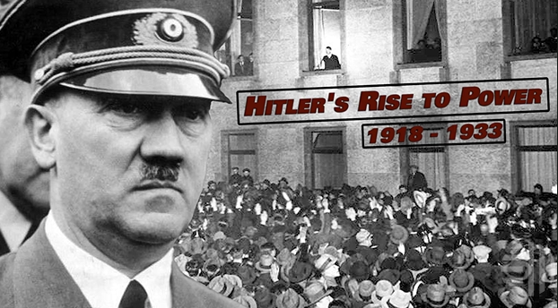

HITLER’S RISE TO POWER
How did the Nazi Party, a small and unpopular political group in 1920, become the most powerful political party in Germany by 1933?
Notes:
https://www.facinghistory.org/resource-library/video/hitlers-rise-power-1918-1933 (9 minutes)
Teacher directions: As you view the film Hitler’s Rise to Power, 1918–1933, record notes that help you answer the questions on the whiteboard (guidance questions below). Watch for moments where choices made by people other than Hitler contributed to Hitler’s and the Nazi Party’s eventual rise to power.
How did German soldiers who returned from World War I affect the way German politics was conducted?
How did the Nazi Party explain Germany’s loss in World War I to the public? Who did the party blame for the loss?
While in prison for his failed attempt at staging a coup in Munich, Hitler wrote Mein Kampf (My Struggle), a book in which he shares his idea for how to take control of a people. What is his main idea?
What was the Nazis’ primary campaign message in the early 1930s? How was it different from what we now know were the Nazis’ two primary goals for Germany? (Primary goal was the forcible acquisition of Lebensraum (living space) for the German people. Secondly, some kind of final reckoning for the Jews.)
Guide notes sourced from https://www.facinghistory.org/chunk/hitler-s-rise-power-1918-1933-viewing-guide

Slide 3
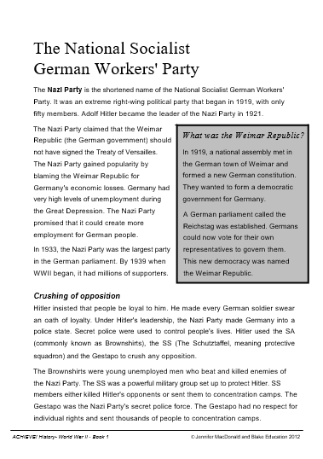

Read ‘the national socialist work’s party’
The National Socialist Work’s Party is a translation of the German
Nationalsozialistische Deutsche Arbeiterpartei
You can see how “Nazi” is an abbreviation of the first word of the party’s name.

Slide 4
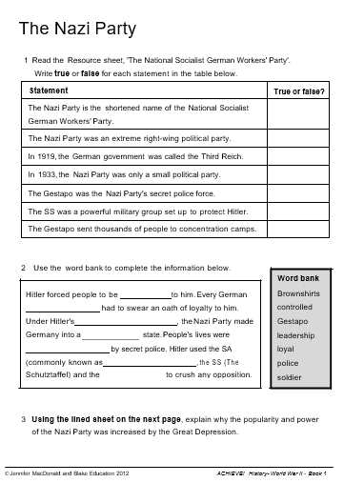

activity
Complete activities 1 and 2 only.
Be ready to share your answers shortly.

Slide 5


Get ready to share (Hands up please) and mark your own work
Statement | True or false?
The Nazi Party is the shortened name of the National Socialist German Workers' Party.
The Nazi Party was an extreme right-wing political party.
In 1919, the German government was called the Third Reich.
In 1933, the Nazi Party was only a small political party.
The Gestapo was the Nazi Party's secret police force.
The SS was a powerful military group set up to protect Hitler.
The Gestapo sent thousands of people to concentration camps.

Slide 6
Statement | True or false?
The Nazi Party is the shortened name of the National Socialist German Workers' Party. | True
The Nazi Party was an extreme right-wing political party.
In 1919, the German government was called the Third Reich.
In 1933, the Nazi Party was only a small political party.
The Gestapo was the Nazi Party's secret police force.
The SS was a powerful military group set up to protect Hitler.
The Gestapo sent thousands of people to concentration camps.

Slide 7
Statement | True or false?
The Nazi Party is the shortened name of the National Socialist German Workers' Party. | True
The Nazi Party was an extreme right-wing political party. | True
In 1919, the German government was called the Third Reich.
In 1933, the Nazi Party was only a small political party.
The Gestapo was the Nazi Party's secret police force.
The SS was a powerful military group set up to protect Hitler.
The Gestapo sent thousands of people to concentration camps.

Slide 8
Statement | True or false?
The Nazi Party is the shortened name of the National Socialist German Workers' Party. | True
The Nazi Party was an extreme right-wing political party. | True
In 1919, the German government was called the Third Reich. | False
In 1933, the Nazi Party was only a small political party.
The Gestapo was the Nazi Party's secret police force.
The SS was a powerful military group set up to protect Hitler.
The Gestapo sent thousands of people to concentration camps.
The German government was called the
Weimar Republic.

Slide 9
Statement | True or false?
The Nazi Party is the shortened name of the National Socialist German Workers' Party. | True
The Nazi Party was an extreme right-wing political party. | True
In 1919, the German government was called the Third Reich. | False
In 1933, the Nazi Party was only a small political party. | False
The Gestapo was the Nazi Party's secret police force.
The SS was a powerful military group set up to protect Hitler.
The Gestapo sent thousands of people to concentration camps.
By 1933 the Nazi Party was the largest party in Germany’s parliament.

Slide 10
Statement | True or false?
The Nazi Party is the shortened name of the National Socialist German Workers' Party. | True
The Nazi Party was an extreme right-wing political party. | True
In 1919, the German government was called the Third Reich. | False
In 1933, the Nazi Party was only a small political party. | False
The Gestapo was the Nazi Party's secret police force. | True
The SS was a powerful military group set up to protect Hitler.
The Gestapo sent thousands of people to concentration camps.

Slide 11
Statement | True or false?
The Nazi Party is the shortened name of the National Socialist German Workers' Party. | True
The Nazi Party was an extreme right-wing political party. | True
In 1919, the German government was called the Third Reich. | False
In 1933, the Nazi Party was only a small political party. | False
The Gestapo was the Nazi Party's secret police force. | True
The SS was a powerful military group set up to protect Hitler. | True
The Gestapo sent thousands of people to concentration camps.

Slide 12
Statement | True or false?
The Nazi Party is the shortened name of the National Socialist German Workers' Party. | True
The Nazi Party was an extreme right-wing political party. | True
In 1919, the German government was called the Third Reich. | False
In 1933, the Nazi Party was only a small political party. | False
The Gestapo was the Nazi Party's secret police force. | True
The SS was a powerful military group set up to protect Hitler. | True
The Gestapo sent thousands of people to concentration camps. | True

Slide 13
You are now ready to complete the part 3 of this activity with Mr McWilliams

Slide 14
Get ready to share (Hands up please) and mark your own work
Hitler forced people to be to him. Every German had to swear an oath of loyalty to him. Under Hitler's , the Nazi Party made Germany into a __state. People's lives were by secret police. Hitler used the SA (commonly known as , the SS (The Schutztaffel) and the ______________to crush any opposition.

Slide 15
Hitler forced people to be to him. Every German
had to swear an oath of loyalty to him.
Under Hitler’s , the Nazi Party made
Germany into a state. People's lives were
by secret police. Hitler used the SA
(commonly known as , the SS (The
Schutztaffel) and the to crush any opposition.
loyal
soldier
leadership
police
controlled
Gestapo
Brownshirts

Slide 16
primary and secondary sources
Brainstorm types of documents you think would fit into each category:
Primary | Secondary

Slide 17
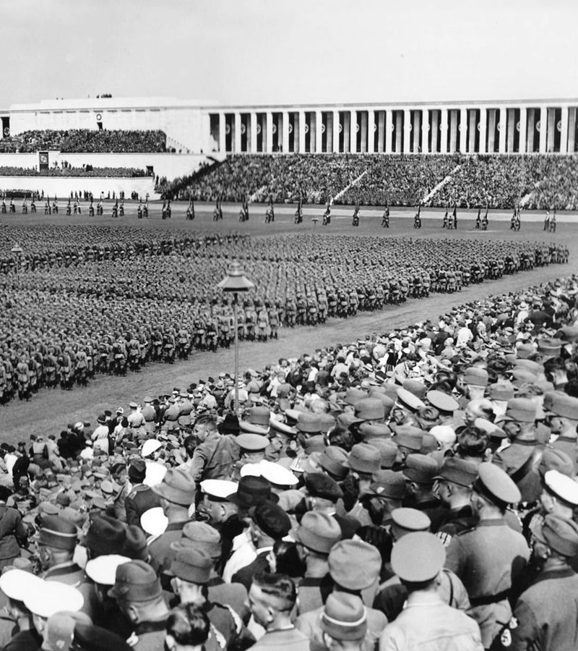
PRIMARY
A photograph taken at the Nuremburg Rally in 1936.
Primary or Secondary Source?
Notes:
Image sourced from https://www.independent.co.uk/news/world/europe/nuremberg-germany-s-dilemma-over-nazis-field-dreams-a6793276.html

Slide 18
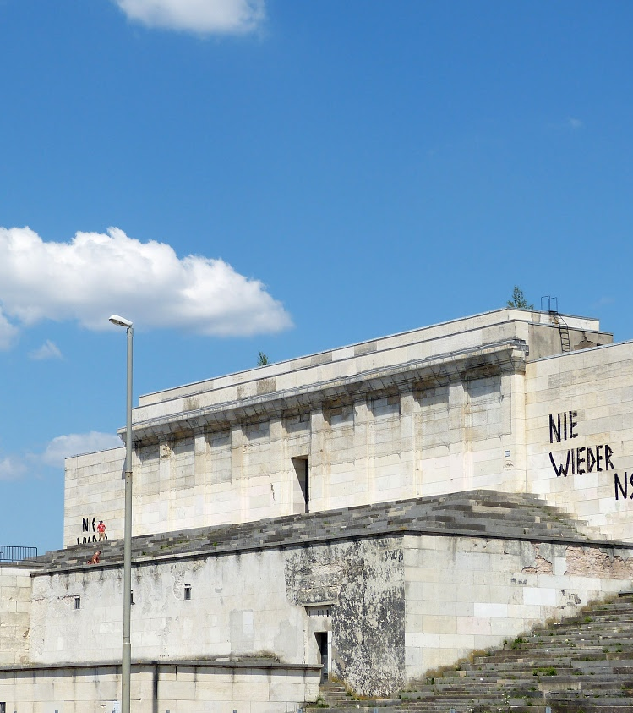
PRIMARY
The Nuremburg hall grandstand today.
Primary or Secondary Source?
Notes:
Source https://artsandculture.google.com/exhibit/the-nazi-party-rally-grounds-in-nuremberg/uQLCnoIq2KGTIg

Slide 19

secondary
A book published in 2012 describing the background to and the development of the Nazi Party Rallies held at Nuremberg each September from 1933 to 1939.
Primary or Secondary Source?
Notes:
https://www.amazon.com/Nazis-Nuremberg-Rallies-James-Wilson-ebook/dp/B00AE7DHRW

Slide 20
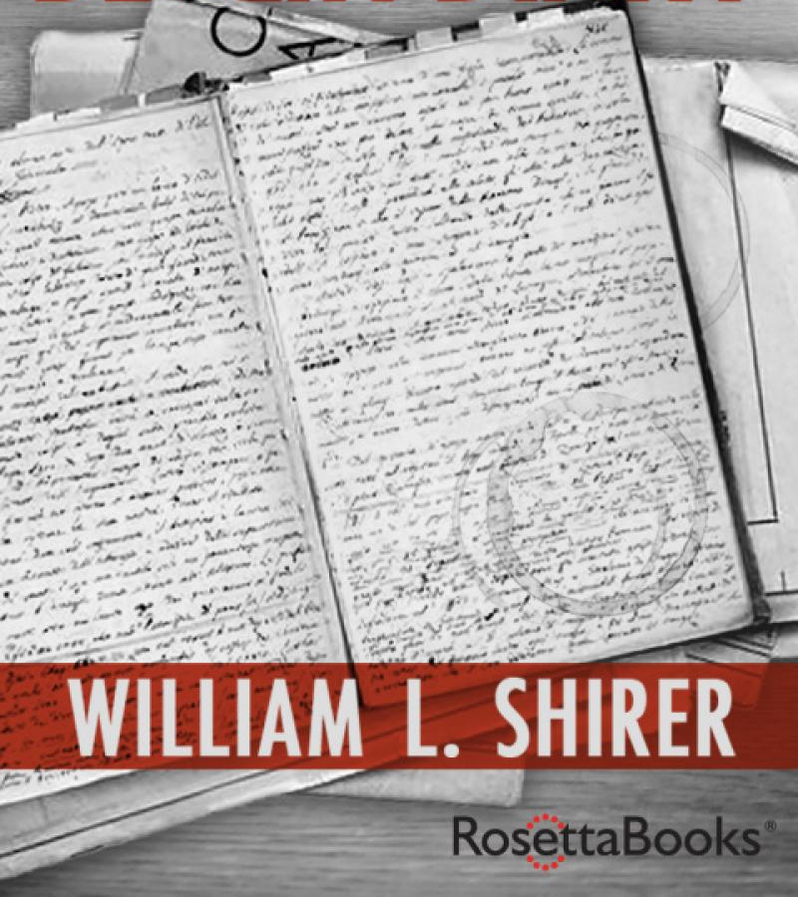
primary
A book published in 2018 written by William L.Shirer a personal memoir of his time as a young journalist who finally fled Berlin in 1940.
Primary or Secondary Source?
Notes:
https://www.haugenbok.no/berlin-diary/shirer-william-l/9780795316982

Slide 21
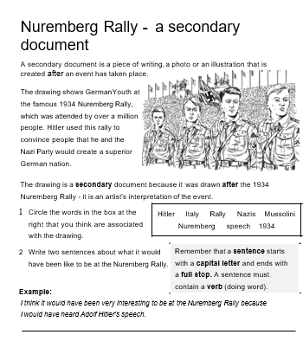
You are now ready to complete the next activity with Mr McWilliams

Slide 22
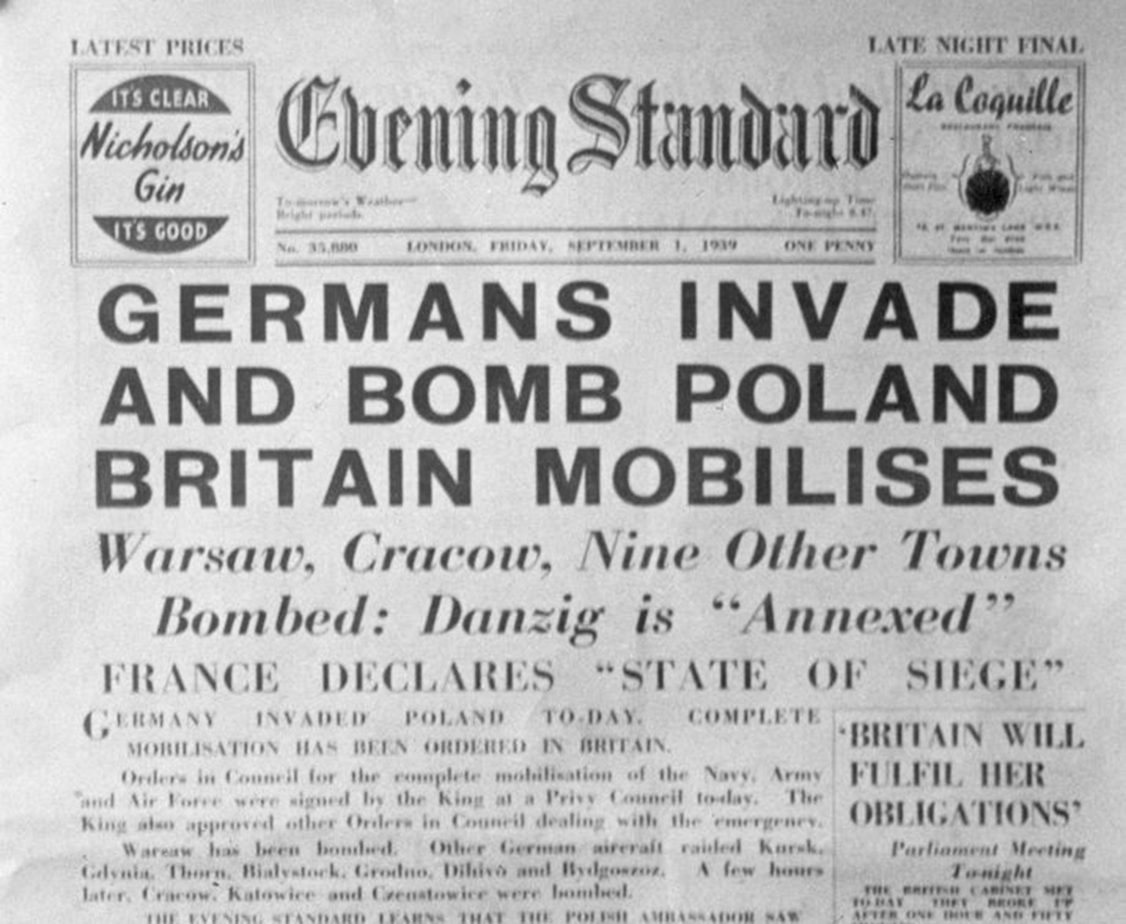
Next time we will be looking into the invasion of Poland

